Slide 1
Big Data Analytics Project Global Warming
Jonas Örnfelt

Slide 2
Background
One of the most crucial tasks in this technology-driven era.
Data confirms that temperatures have changed globally.
Leads to rising sea levels, extreme weather events, shifts in natural environments, and more.
Affects globally and locally.
Mainly caused by human actions, such as burning fossil fuels

Slide 3
Research questions
Is global warming, as a critical issue, a recent phenomenon? - Has global warming always been here or has it emerged recently (last two decades)? - Where does it come from? - Natural event or man-made?
How do the temperature changes differ from Earth’s continents? - Temperature changes on a broader scale. - What circumstance have led to the changes?

Slide 4
Approach
Data from Food and Agriculture Organization of the United Nations (FAOSTAT). Granted use through FAO Statistical Database Terms of Use license.
Study the effects of global warming - which areas are affected the most?
Underlying factors contributing to climate change, as well as strategies to lessen its impact.
Informing about the reality of global warming.

Slide 5
The Dataset
190 countries and 37 other territories.
CSV with 9656 rows and 66 columns.
1. Area: countries or areas.
2. Area Code: numerical integer of area column.
3. Element Code: numerical integers for mapping elements.
4. Element: Objects related to either 'Temperature Change' and 'Standard Deviation'.
5. Months Code: numerical integers for mapping months.
6. Months: Includes Meteorological year, month, season.
7. Unit: The Celsius degree (°C).

Slide 6
Result
Plots generated based on data.
Confirms the two research questions and related ones.
Worth investigating specific areas since the risk of tragic natural events occurring has increased during recent years.

Slide 7
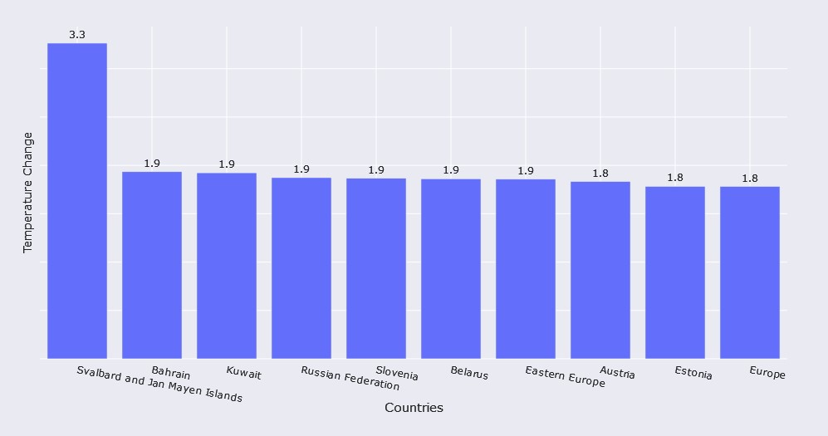
Areas with highest temperature changes

Slide 8
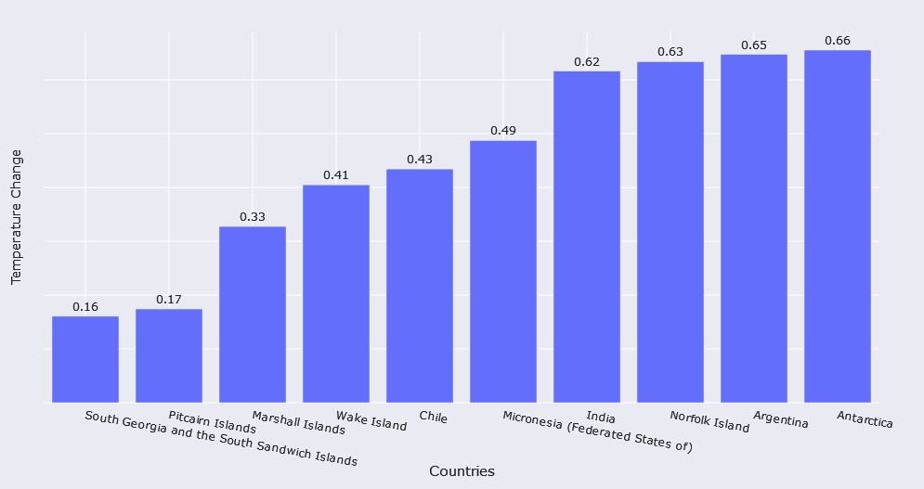
Areas with lowest temperature changes

Slide 9
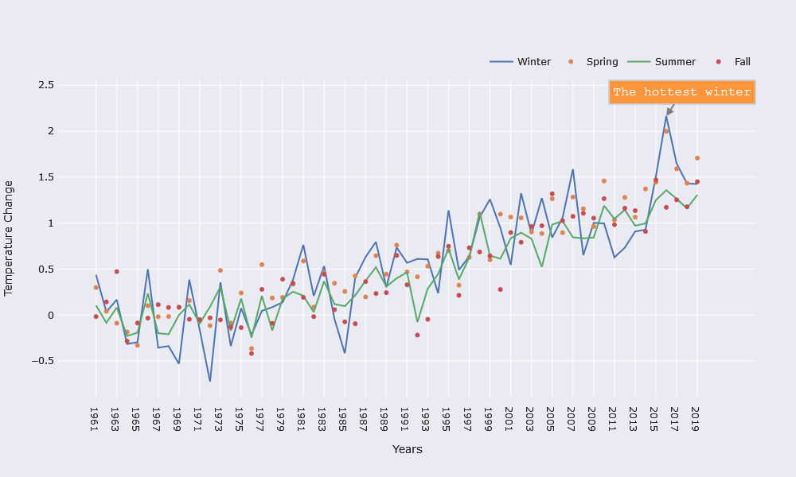
Seasonal changes

Slide 10
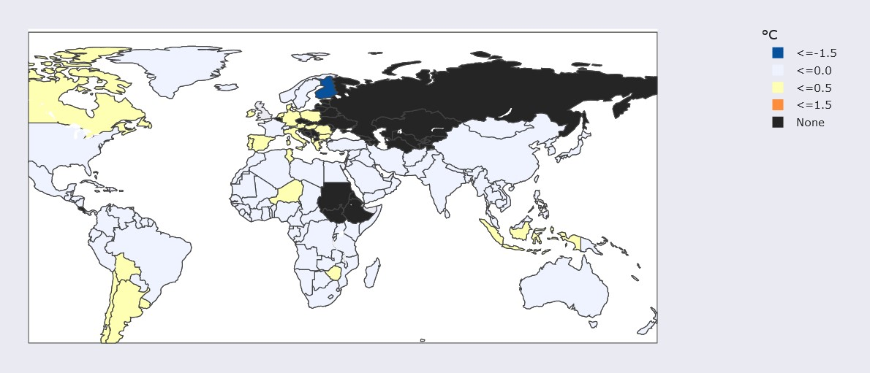
Map of temperature changes - 1968

Slide 11
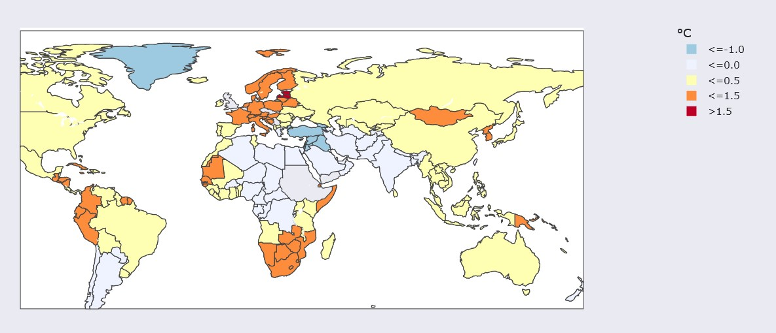
Map of temperature changes - 1992

Slide 12
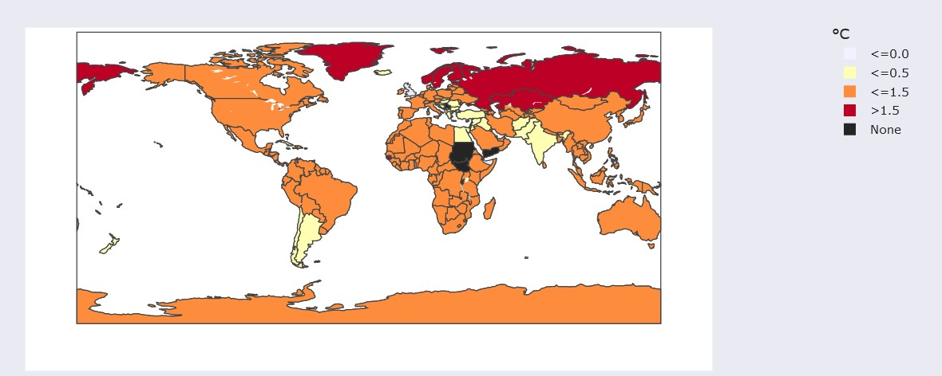
Map of temperature changes - 2005

Slide 13
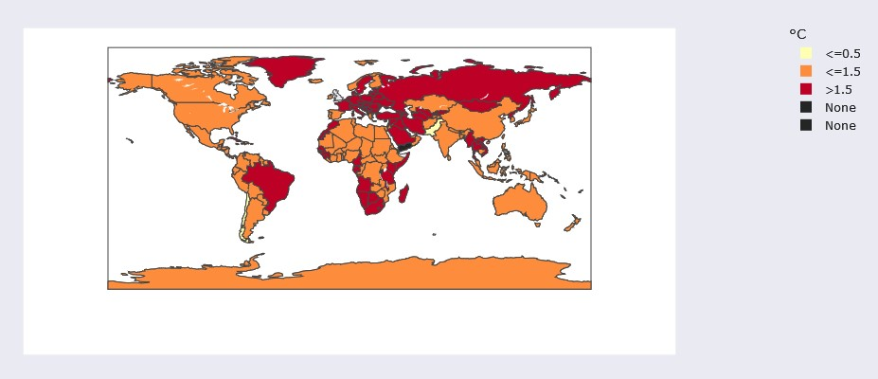
Map of temperature changes - 2019

Slide 14
Ethics
Data quality: - Reliability. - Weather modifications.
Type of actions?
How much?
Drastic changes vs. slow and moderate approaches.

Slide 15
Conclusion
Global warming is projected to have devastating effects on the Netherlands due to its low elevation.
Icy climates might become viable locations for agriculture.
We need to: - Reduce CO2 emissions. - Switch from fossil fuels to renewable sources of energy. - Reduce existing CO2 in the atmosphere.
Future work: - Try to verify the results and see if it differs. - Compare with future data. - Areas can be examined further. For example, how does the ratio of electrical vehicles and fossil fueled vehicles affect the local temperatures.

Slide 16
The End

